Slide 1
Northrop Grumman:
Secure State Estimation
HMC Team:
Robert Cyprus (S)
Aishvarya Korde (S)
Zayra Lobo (J)
Paige Rinnert (Fall TL)
Advisor: Professor Chris Clark
Liaisons: Ken Dreshfield ‘80
Ian Jimenez ‘11
Ron P. Smith ‘83
Stephanie Tsuei (Lead)

Slide 2
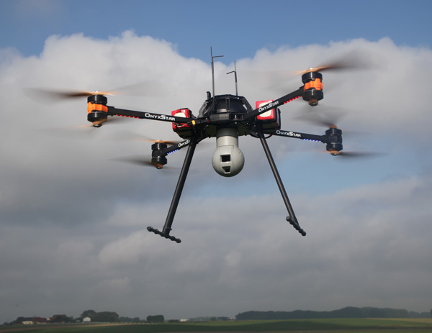
Overview
Project Description
Project Statement
Objectives, Constraints & Functions
Deliverables
Theory
Control Loop
Dynamic Model
Optimization Algorithm
Hardware Selections
Current Progress
Gantt chart
Questions
https://en.wikipedia.org/wiki/Quadcopter

Slide 3


Project Statement
The Northrop Grumman Clinic Team will implement a secure state estimator in software and then experimentally validate the estimator in hardware. The team will demonstrate that the addition of the SSE algorithm to the control loop reduces the real-time tracking error of a quadrotor when using measurements from compromised onboard sensors.

Slide 4
Project Statement
The Northrop Grumman Clinic Team will implement a secure state estimator in software and then experimentally validate the estimator in hardware. The team will demonstrate that the addition of the SSE algorithm to the control loop reduces the real-time tracking error of a quadrotor when using measurements from compromised onboard sensors.

Slide 5
Project Statement
The Northrop Grumman Clinic Team will implement a secure state estimator in software and then experimentally validate the estimator in hardware. The team will demonstrate that the addition of the SSE algorithm to the control loop reduces the real-time tracking error of a quadrotor when using measurements from compromised onboard sensors.

Slide 6
Project Statement
The Northrop Grumman Clinic Team will implement a secure state estimator in software and then experimentally validate the estimator in hardware. The team will demonstrate that the addition of the SSE algorithm to the control loop reduces the real-time tracking error of a quadrotor when using measurements from compromised onboard sensors.

Slide 7
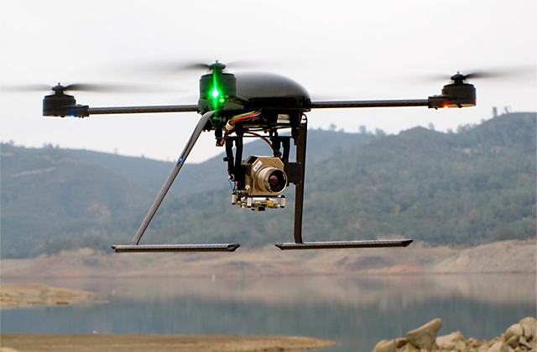
Objectives
Demonstrate quadrotor altitude tracking control with minimal tracking error [m]
Maximize the number of compromised sensors for which the SSE can be tested
Minimize cost
http://illumin.usc.edu/162/the-quadrotors-coming-of-age/

Slide 8
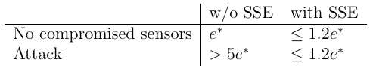
Constraints
SSE must reduce tracking error when sensors are compromised:
Final implementation of the SSE must be in ROS
Quadrotor must fly for 10 minutes on a single battery charge
Must estimate states at a frequency of at least 25 Hz
Equipment and supplies < $7,000
Notes:
This needs to be changed to 1.2e*? Done!

Slide 9
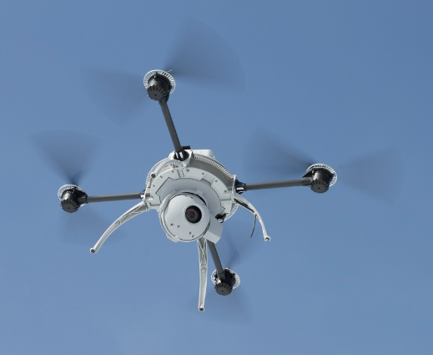
Functions
Quadrotor should complete pre-planned altitude profile with compromised sensors
Quadrotor should perform real time state estimation and correction
The SSE must be configurable to receive correct data from sensors or overwrite data from specified sensors to simulate hacking
The SSE should estimate the state of the quadrotor (position [m], velocity [m/sec], orientation [°], angular velocity [°/sec])
http://spectrum.ieee.org/automaton/robotics/military-robots/aeryon-scout-quadrotor-spies-on-bad-guys-from-above

Slide 10
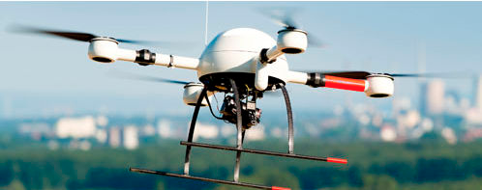
Deliverables
Fall Semester
Implement and simulate a state estimator in Matlab
All sensors functioning
Some sensors compromised
Successfully log sensor data
Produce a functioning quadrotor with onboard computer, controller, and sensors
Spring Semester
Test state estimator on real sensor data
Some corrupted measurements
Offline and in real time
Demonstrate quadrotor flight with real time data logging and state estimation
http://zacharytylerpoole.blogspot.com/2013/09/personal-uavs-for-public-use.html
Notes:
ZL

Slide 11
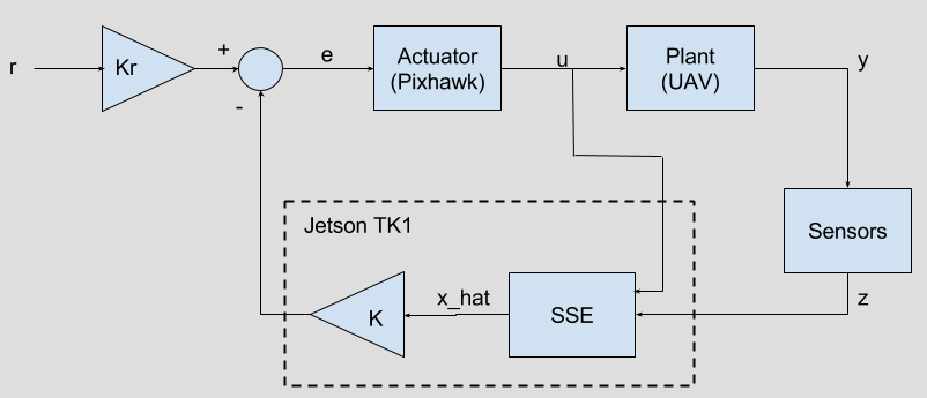
Preliminary Control System Outline

Slide 12
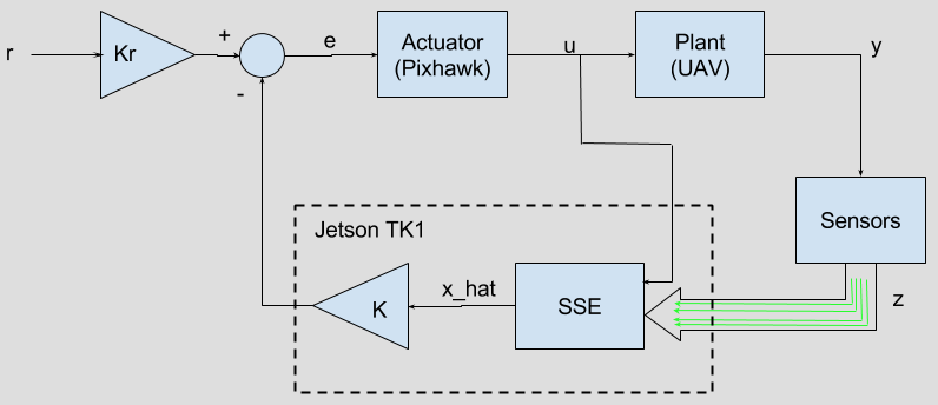
Preliminary Control System Outline
Functioning Sensors

Slide 13
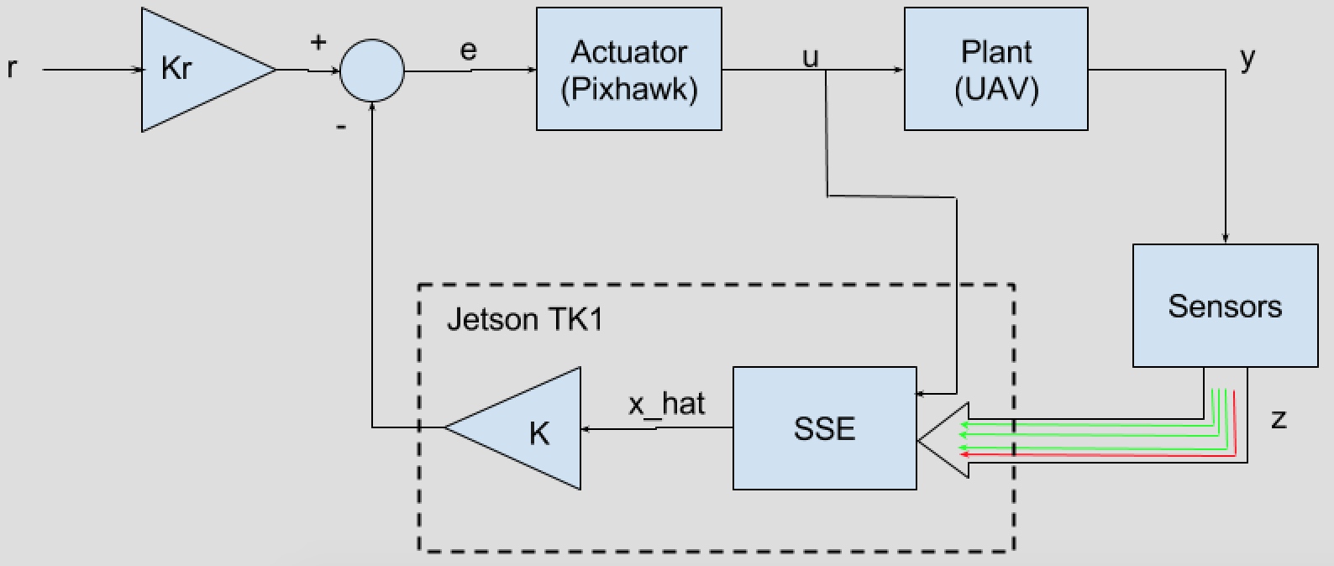
Preliminary Control System Outline
Functioning Sensors
Compromised Sensors

Slide 14
Preliminary Control System Outline
Dynamic
Model

Slide 15
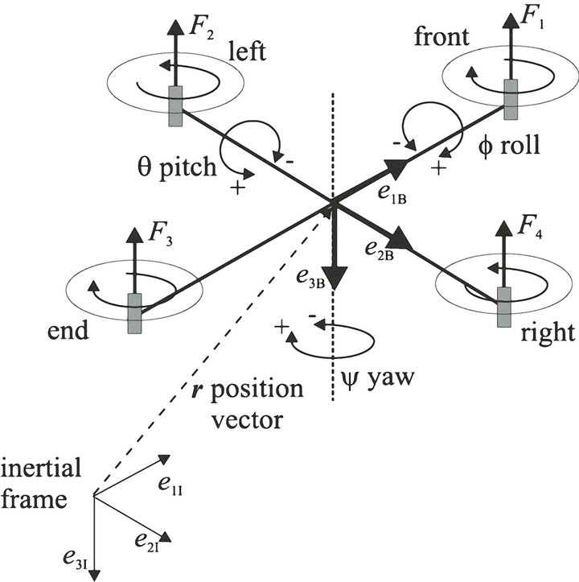
Quadrotor Dynamic Model: Coordinate Definitions
Body frame
http://file.scirp.org/Html/12-7900231_35654.htm
Notes:
What is the picture? The slide should stand alone--should be words describing what this is, even as simple as “Defining coordinates for dynamic model”

Slide 16
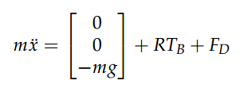
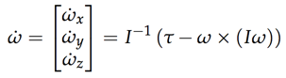
Dynamic Model
 | Thrust vector in body frame
 | Drag force
 | Rotation matrix (linear)
 | Inertia matrix
 | Torques in body frame
 | Angular velocity
 | Rotation matrix (rotational)
Linear Motion
Rotational Motion
http://andrew.gibiansky.com/downloads/pdf/Quadcopter%20Dynamics,%20Simulation,%20and%20Control.pdf

Slide 17
Preliminary Control System Outline
Optimization Algorithm

Slide 18
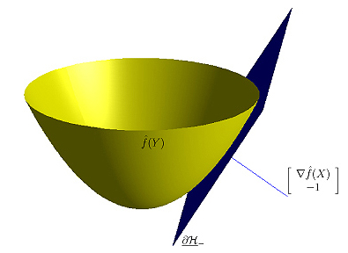
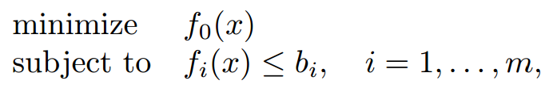
Convex Optimization
Special class of optimization problems
Least squares programming (LP)
Quadratic programming (QP)
Programs exist to translate a mathematical problem and find the solution (e.g. CVX)
Recent advances have reduced solution times
Applications in control, circuit design, economics, machine learning, etc.
http://stanford.edu/~boyd/papers/pdf/rt_cvx_sig_proc.pdf
http://www.convexoptimization.com/dattorro/convex_functions.html

Slide 19
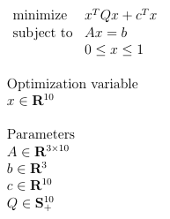
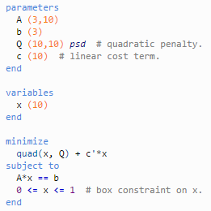
Optimization Example - Quadratic Programming
Mathematical representation:
CVX code (CVXgen):

Slide 20
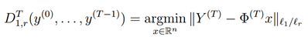
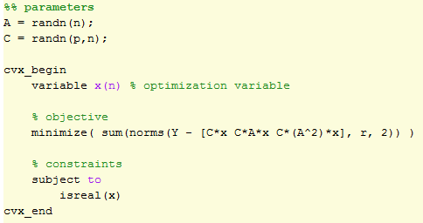
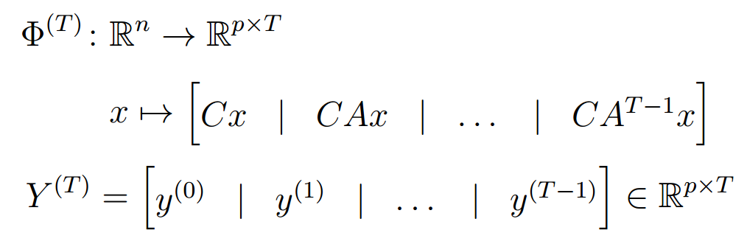
SSE Optimization Algorithm
Mathematical representation:
CVX code:
SSE algorithm is currently functioning in Matlab
Working on using CVXgen to generate solver code

Slide 21
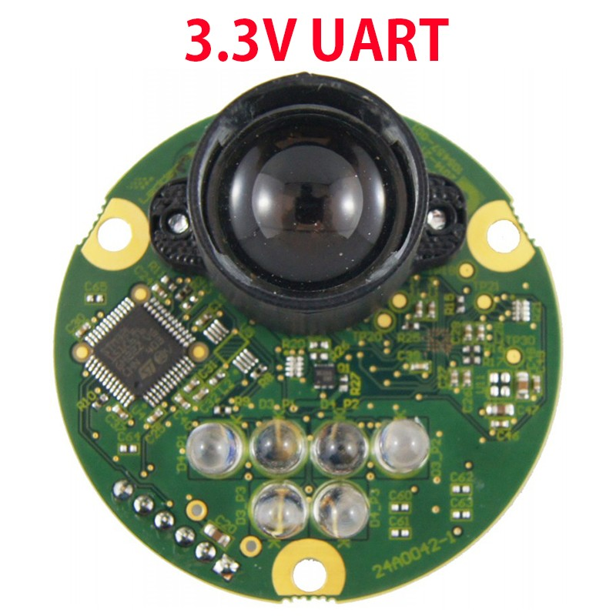
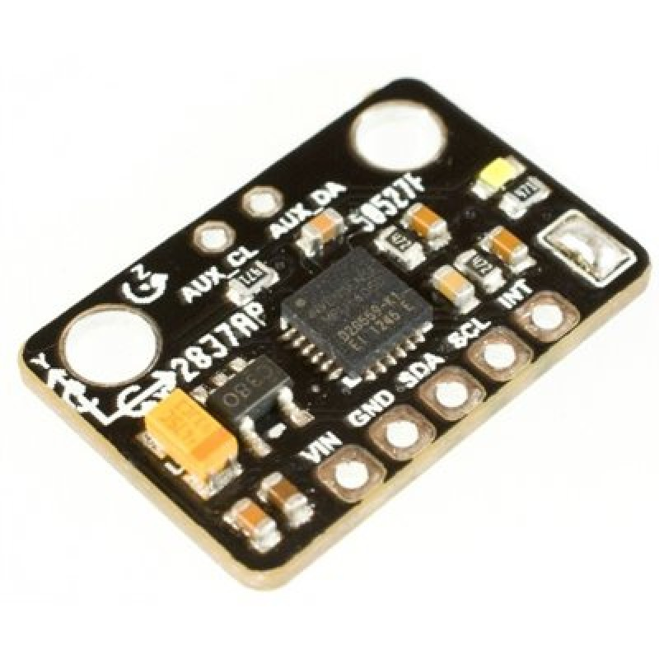
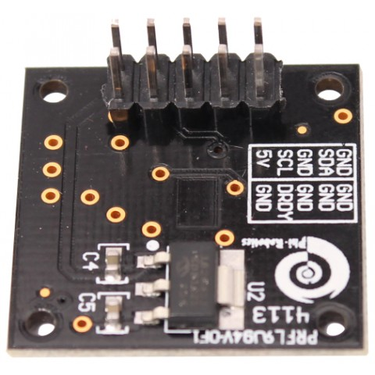
Hardware Requirements - Sensors
3-DOF Position/Velocity | 3-DOF Orientation/Angular Velocity
3-DOF Accelerometers Laser scanner OptiTrack vision system | 3-DOF compass Gyroscopes (3)
Laser scanner
IMU (3 accelerometers & 3 gyroscopes)
Compass

Slide 22
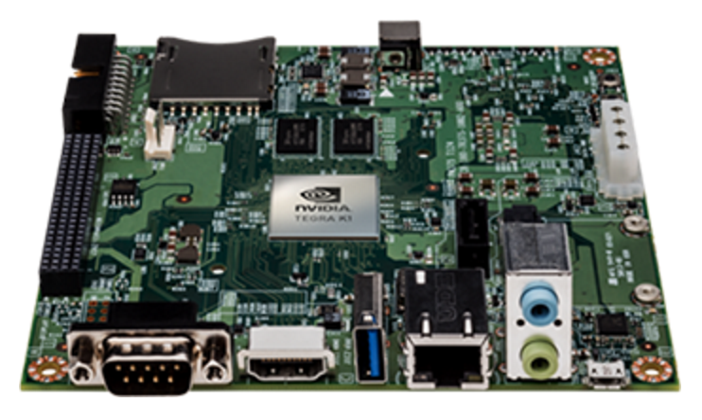
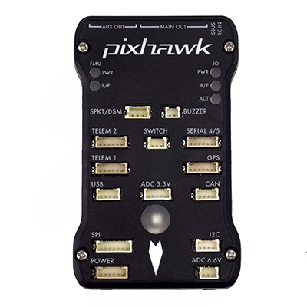
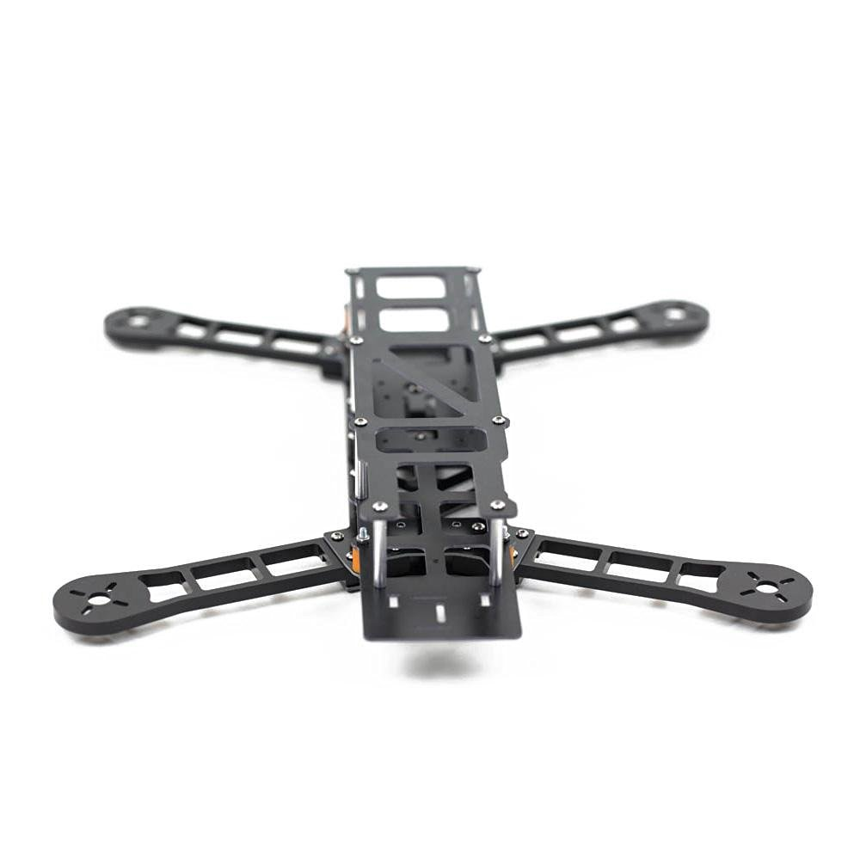
Hardware Requirements - Flight hardware
Onboard computer
Jetson TK1 board
Flight controller
3DR Pixhawk
Quadrotor frame
QAV400
Lightweight
Easily customizable
http://www.nvidia.com/object/jetson-tk1-embedded-dev-kit.html
http://www.desertaircraft.com.au/shop/qav400-fpv-quadcopter-frame-arf.html
http://www.hover-bike.com/MA/product/pixhawk/

Slide 23
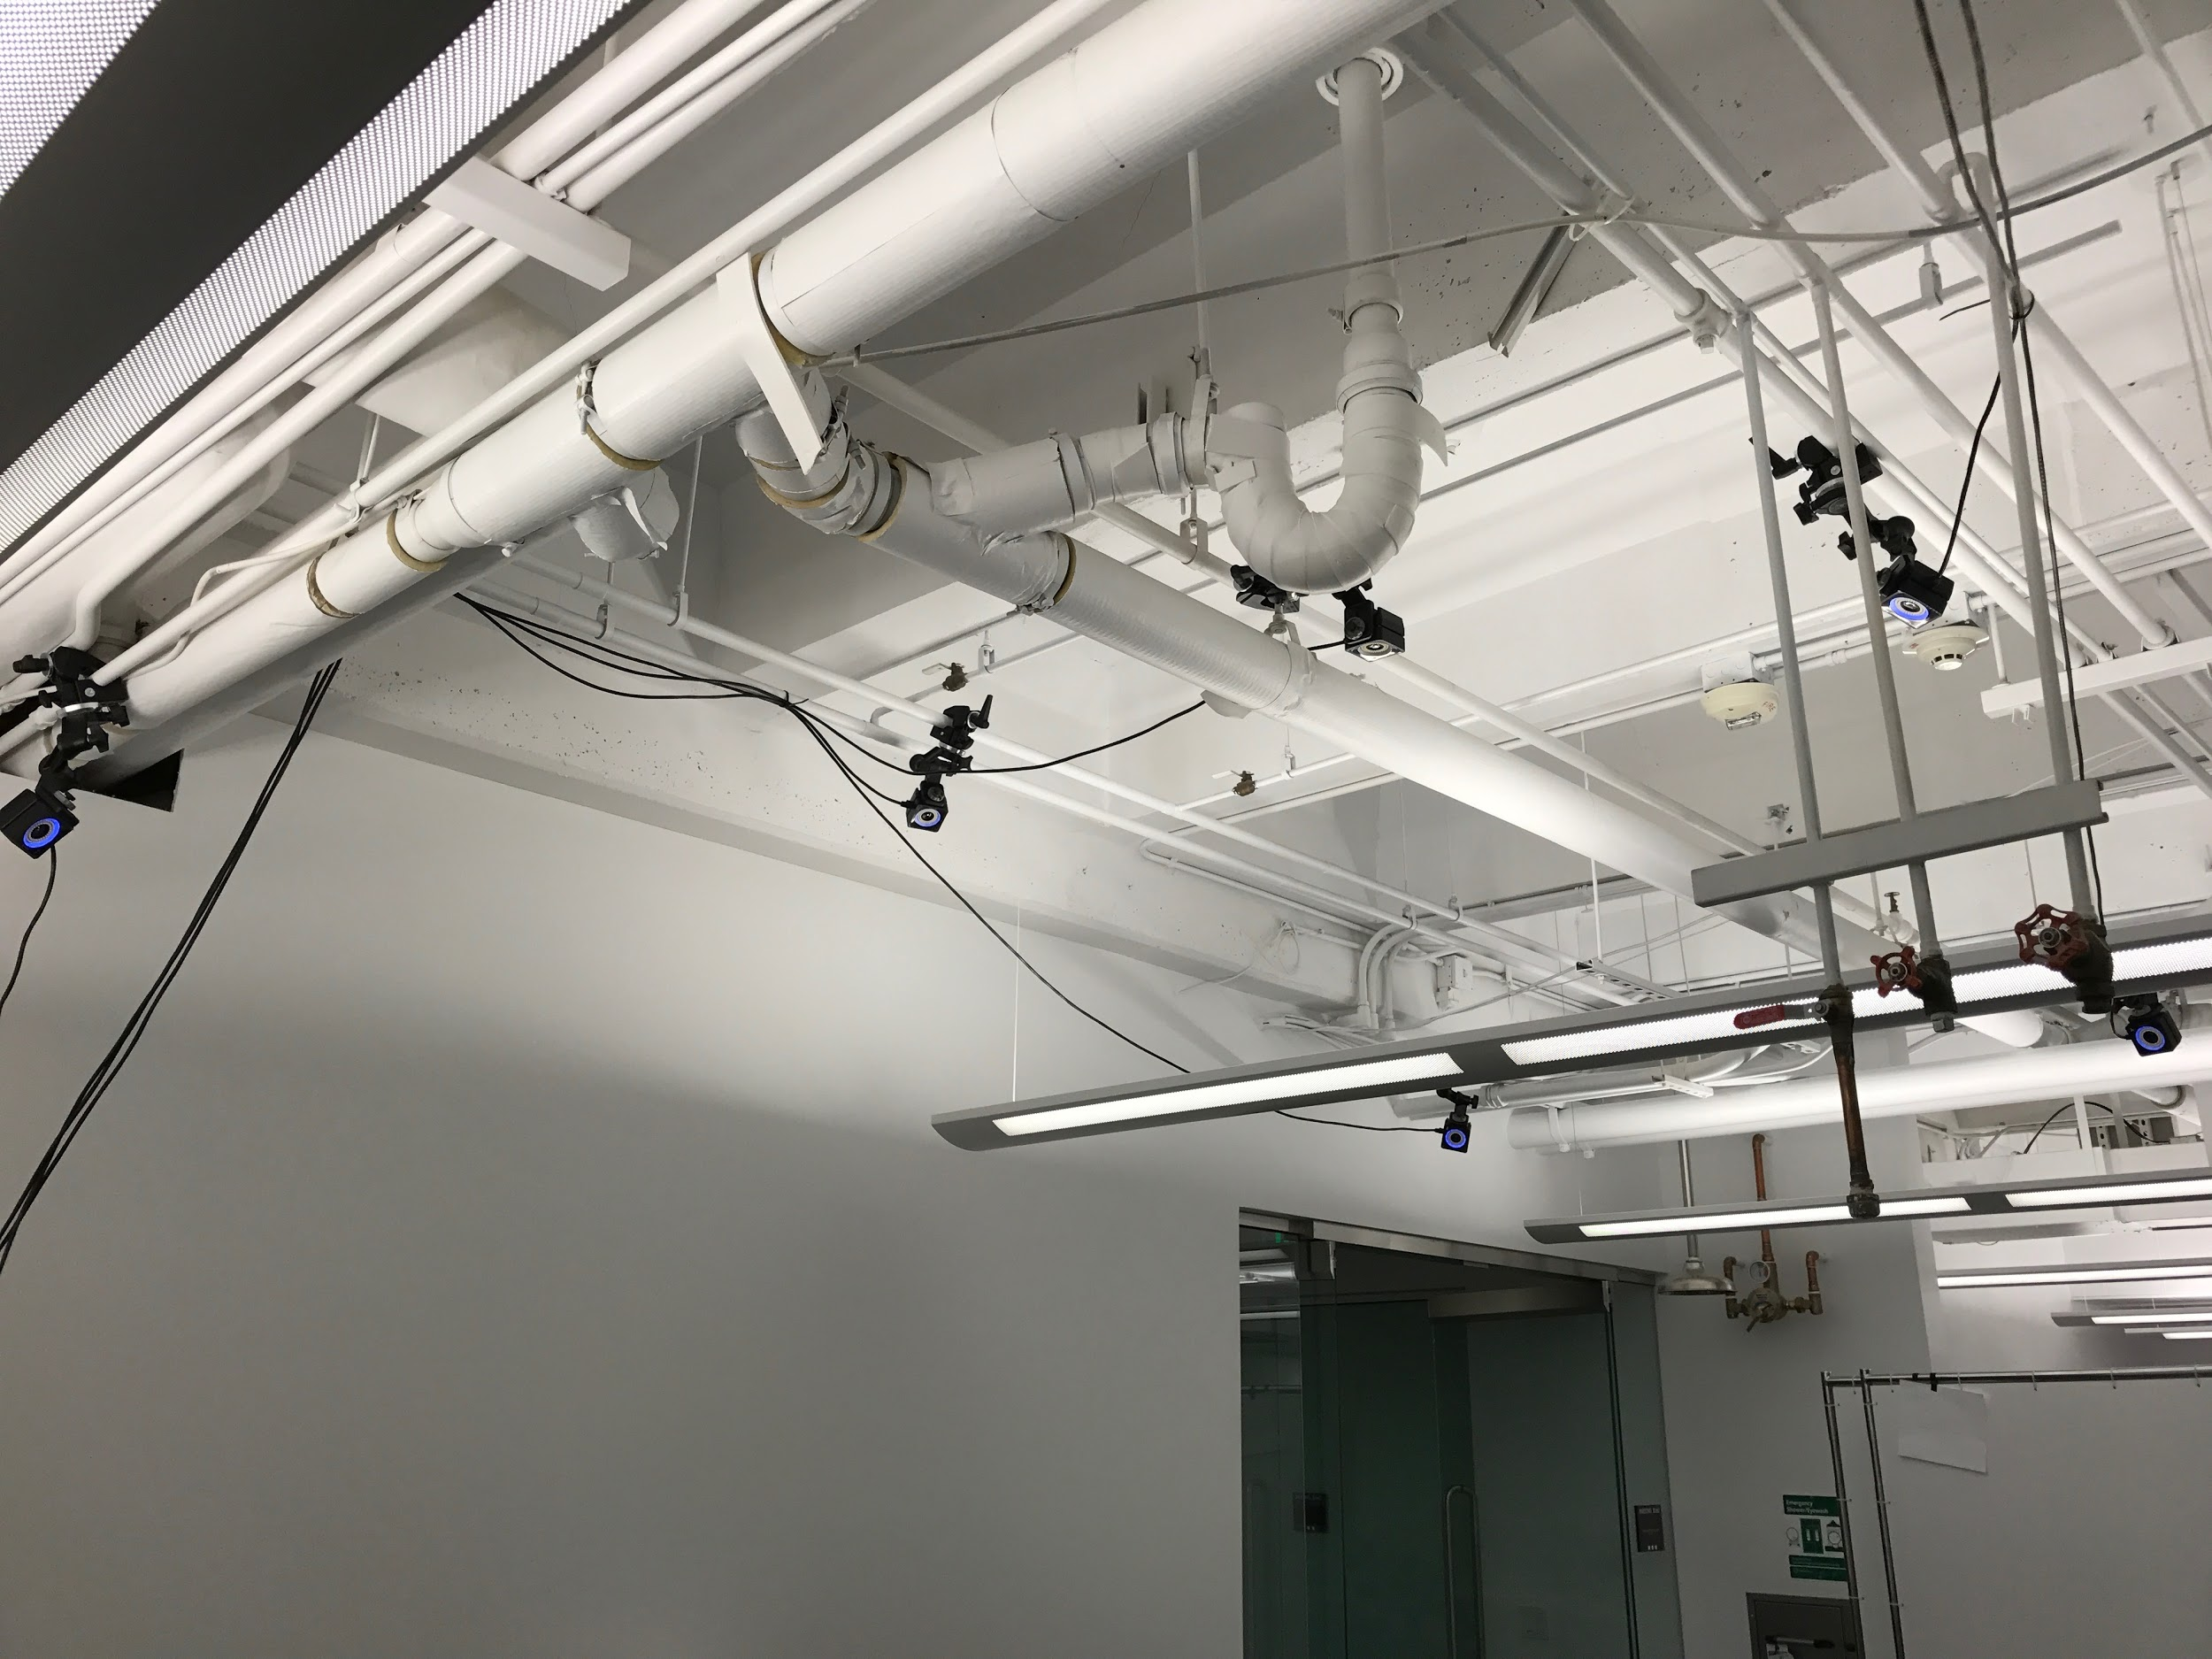
Optitrack Motive: Camera Positions

Slide 24
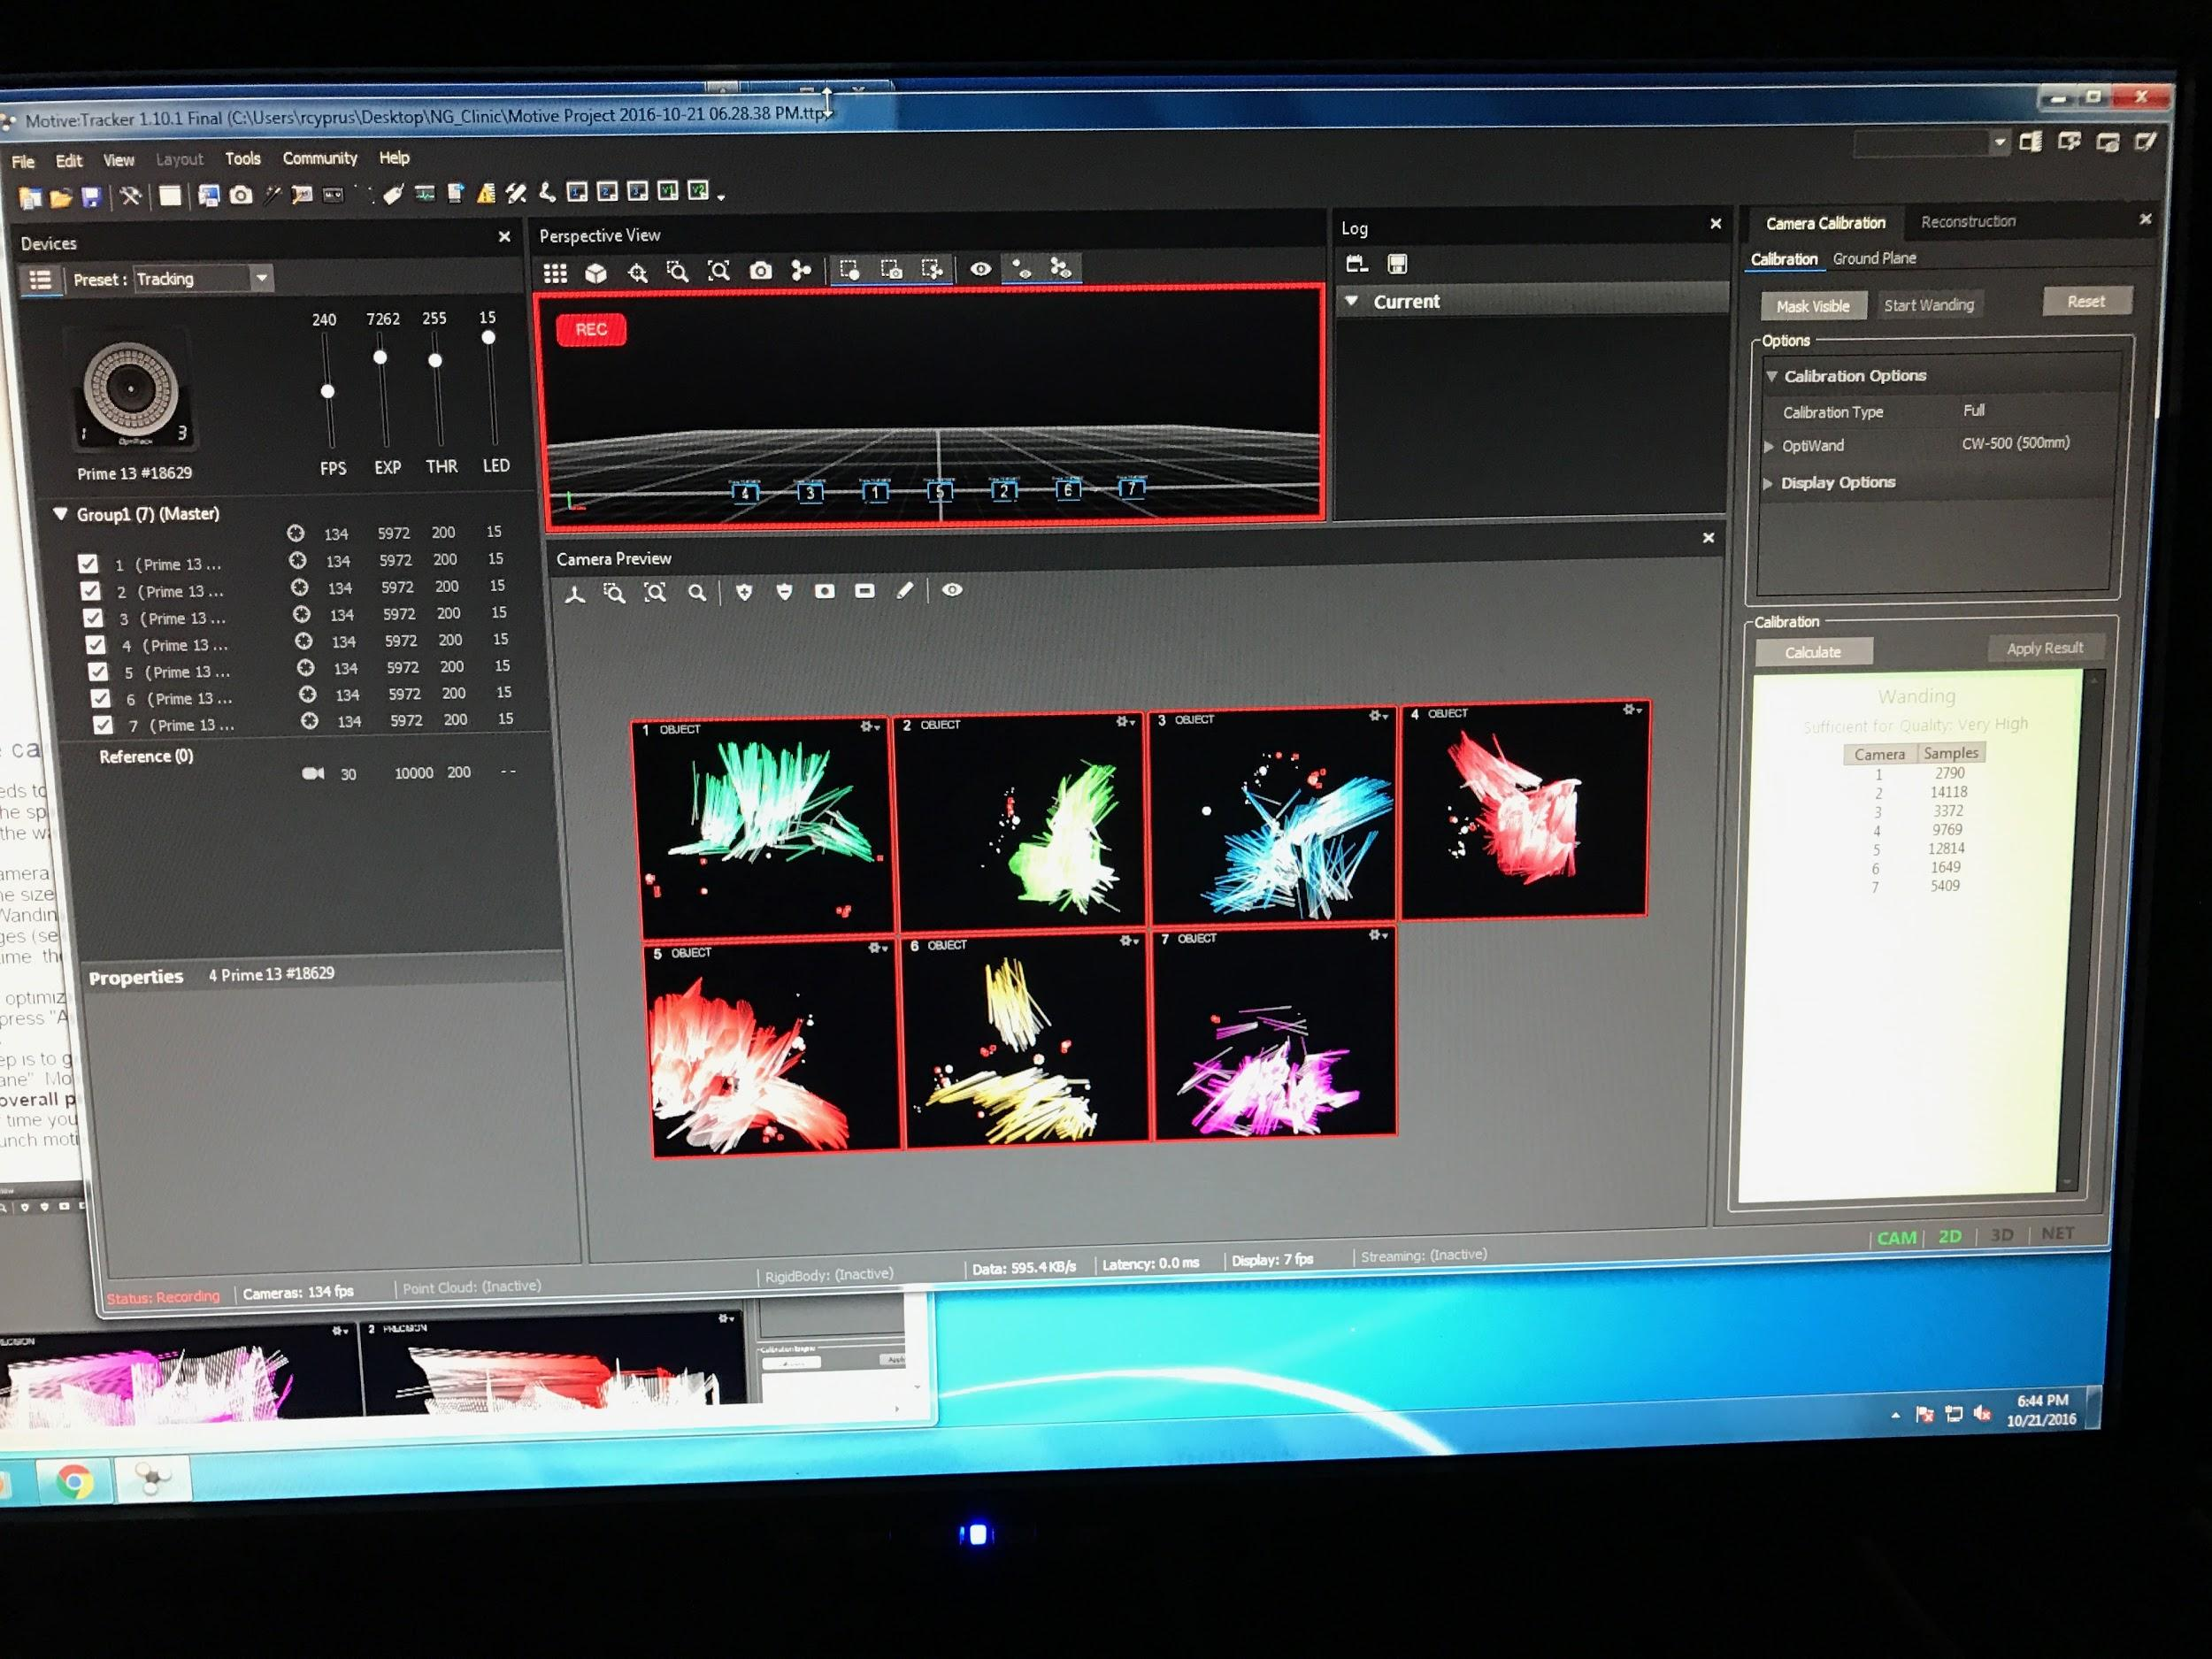
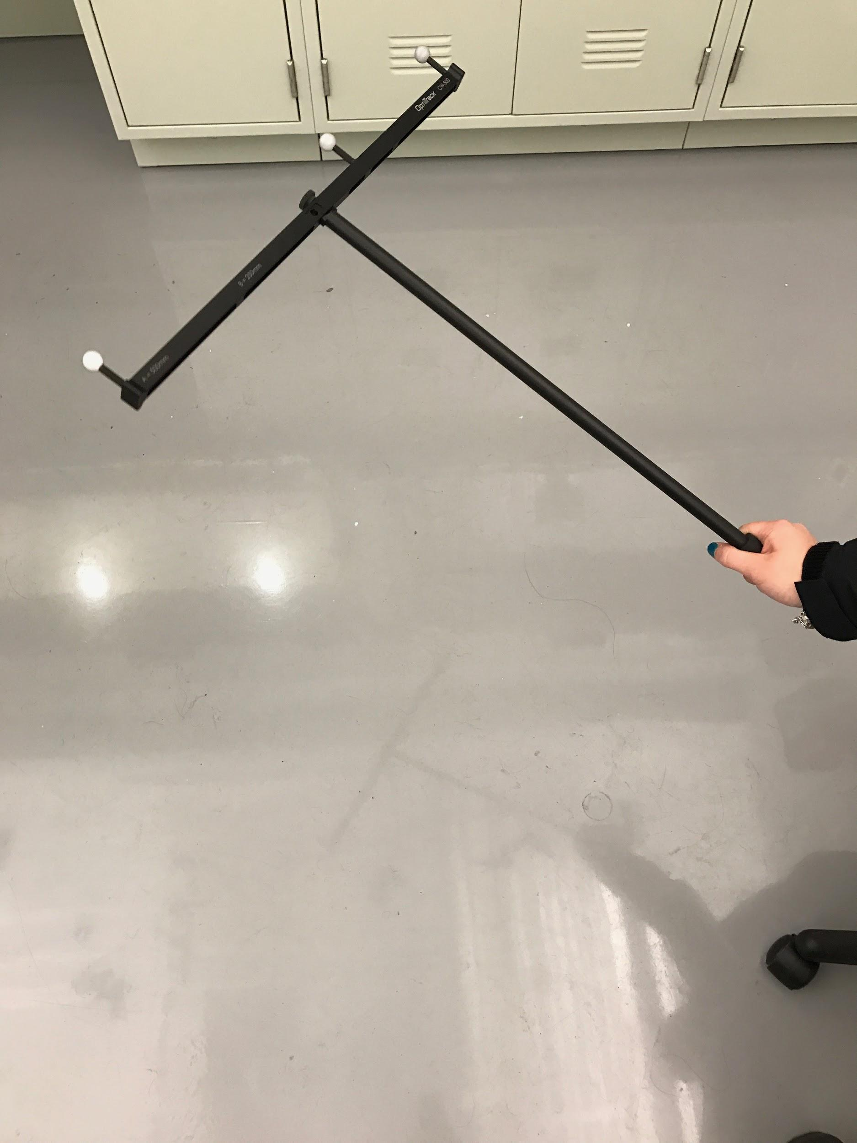
Optitrack Motive: Calibration

Slide 25
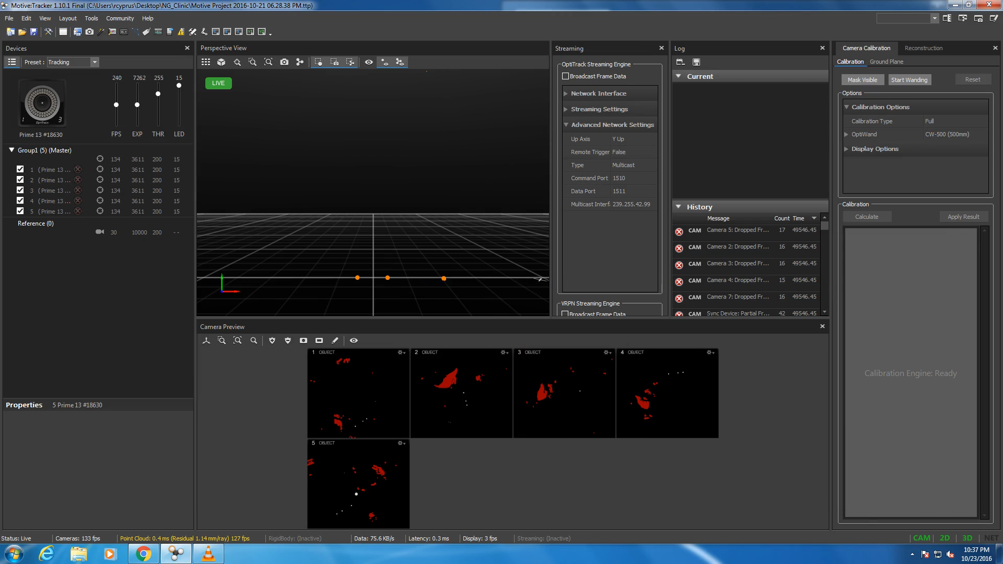
Optitrack System: Example Tracking

Slide 26
Current Progress and Short Term Goals
Current progress
Completed workplan
Purchased controller, onboard computer and sensors
Setup and calibrated OptiTrack vision system
Short-term goals
Finish quadrotor research and purchase equipment
Start simulation of quadrotor dynamic model
Continue to improve SSE algorithm in Matlab
Calibrate sensors

Slide 27
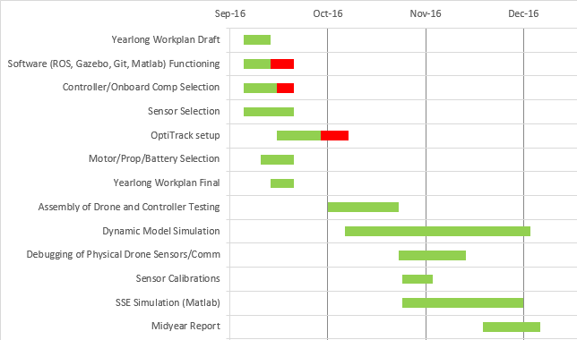
Current Progress - Fall semester Gantt chart

Slide 28
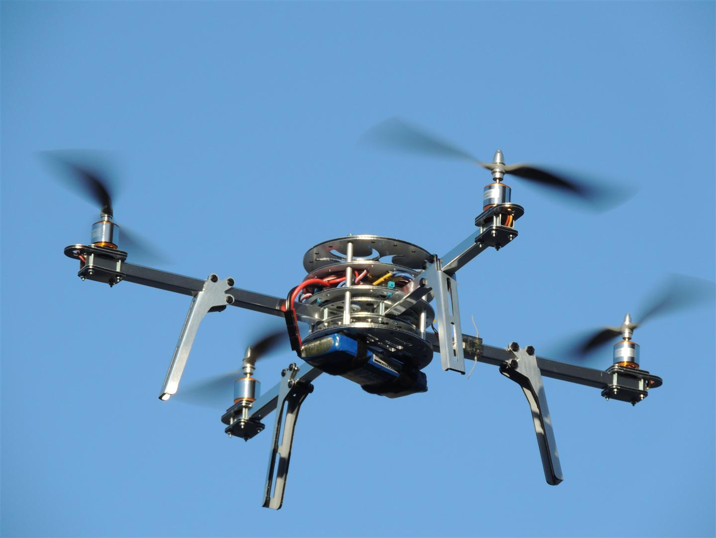
Questions?
http://technozion.org/tz15/home/events/quadcopter

Slide 29
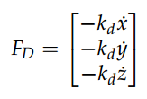
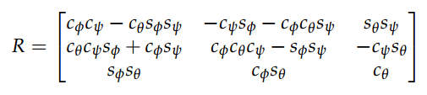
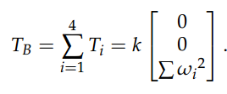
Linear Motion
Drag Force
Rotation matrix for relating body frame to inertial frame
Thrust vector in body frame
http://andrew.gibiansky.com/downloads/pdf/Quadcopter%20Dynamics,%20Simulation,%20and%20Control.pdf

Slide 30
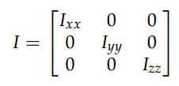
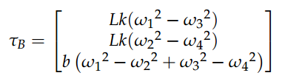
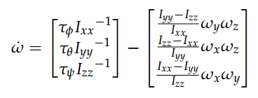
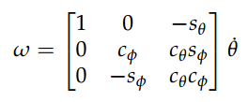
Rotational Motion
Inertia matrix
Torques in the body frame
Angular velocity in body frame
Rotation matrix for relating body frame to inertial frame for rotational motion
http://andrew.gibiansky.com/downloads/pdf/Quadcopter%20Dynamics,%20Simulation,%20and%20Control.pdf

